Slide 1
Third Grade
2019-2020
Ms. Abel

Slide 2
Welcome to third grade at Marshall! I am so happy to have your child in my class this year! This handbook is designed to give you most, if not all, of the information you will need throughout the school year. Thank you for taking the time to read this information and discuss it with your child.
If you have any questions about the information contained in this handbook, feel free to email me at eabel@bcpsk12.net.
Arrival and Dismissal
Students are allowed to come down to the classroom at 8:25. They will begin with the morning routine and morning work before we have our morning meeting at 8:45. If your child will be late or absent on any given day, please email Suzy Mason at smason@bcpsk12.net and copy me as well. Dismissal is at 3:40. If there is a change in how your child gets home, please write me a note or email me so there is no confusion.
Capturing Kids’ Hearts & Classroom Discipline
In my classroom, I use Capturing Kid’s Hearts as a way to build relationships between myself and the students and between the students as peers. The first week of school, we create a Social Contract together as a class that we follow all year long. Every day we start fresh, so I use the following disciplinary actions as needed:
1. Privately question the student – ask what choice they are making & help redirect them
2. Warning – warn the child that if this happens again, there will be consequences
3. Think Sheet – Students take a short time out to fill in a think sheet. This will be sent home and must be signed and returned the following day
4. Parent Meeting – Parents will be requested to come in to meet with the student and the teacher
5. Meeting with Principal – If behavior continues, we will all meet with the principal
`

Slide 3
Take Home Folders and Planners
Every child will be given a Take Home Folder and a weekly planner sheet. This folder and planner will be sent home each night and needs to be brought back to school every day. Notes, graded work, and classroom news will be put in this folder. The weekly planner will be filled out daily.
Newsletters
Every Friday I send home a newsletter. It will go home in students’ take home folders. I also will be updating a classroom website that will store printables, newsletters, and other helpful resources throughout the year. I will send the URL for the site home the first week of school.
Book Orders
There will be book orders sent home throughout the year. If you would like to order books, please go to www.scholastic.com and use our classroom code LB64P. I will put in my newsletter when the orders are due.
Specials
Every child will need to keep a pair of gym shoes and
an art shirt in their lockers for the duration of the school year.

Slide 4
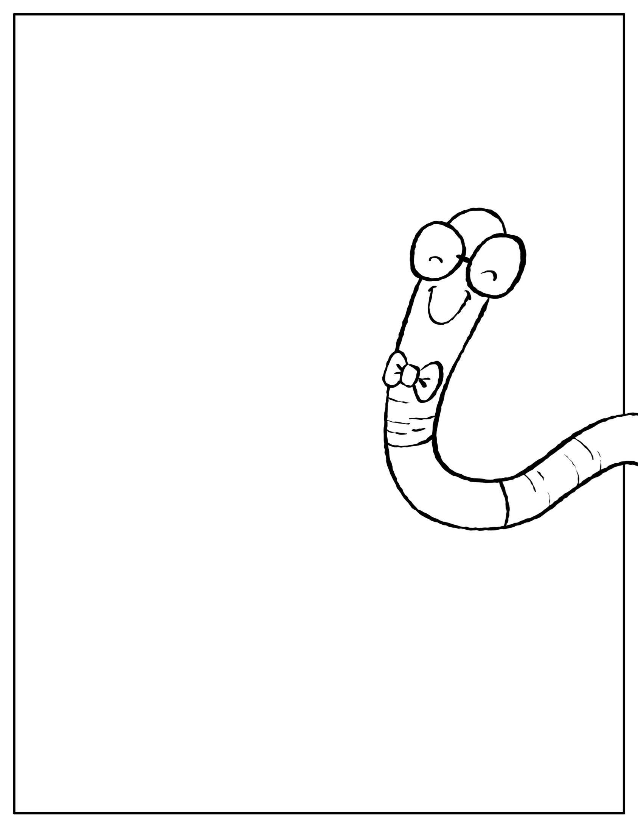
Homework
Research indicates that reading is one of the most important skills that students need for success. I am dedicated to growing your child into a strong, fluent reader, but I need your help! Please read 20 minutes with your child at home each night. Students will learn how to fill out reading logs the second week of school and that will be a part of their homework packet. Each packet will be handed out on Friday and due the following Friday. The packets will include:
Reading Log
Spelling Practice
Additional work they missed throughout the week if needed
Snack Time
Every day we have a designated snack time. Students are welcome to bring a nutritious snack from home. For example: fruits, vegetables, crackers, granola bar, cheese, healthy cereal, etc. (No pop/candy). Students may also bring bottles of water as long as it has a lid. If your student does not bring a snack from home, I have extra snacks here at school.
Toys/Personal items
Students are not to bring toys to school. If they bring something for recess, it is their responsibility to take care of it and put it back in their lockers after recess.

Slide 5
Birthdays
Feel free to have your child bring in birthday treats for their classmates on their special day! I always keep extras in the room, so if you are not able to bring treats for your child I will have some available.
If your child is having a birthday party and you would like to send invitations to school, please make sure ALL of their classmates are invited to the party. Please do not send invitations to school for just a few students.
All About Me Bags
Each week, a new student will get to take a special bag home on Friday. They can fill it with up to 8 items that represent them or that are special to them. On Monday, they will take the honorary seat and share all about themselves to the class. They will be celebrated that week!
Classroom Library Books
I love kids to check out books in our classroom library and take them home! Please just be sure that every book makes it back to the classroom library within two weeks time. Students are allowed to check out 2 books at a time. Every child will receive a book bag with a reading log, reading materials and then the books they are working on. This goes home every night and must come back every morning. It is important that students work on reading one book at a time.
Curriculum
Math: We cover a lot of math in third grade! Every day we will have a lesson, and the students will have different opportunities each day to practice the skill we learned in a different way. We cover multi digit addition and subtraction, multiplication and division (facts 0-10), fractions, measurement, time and elapsed time, and graphing.

Slide 6
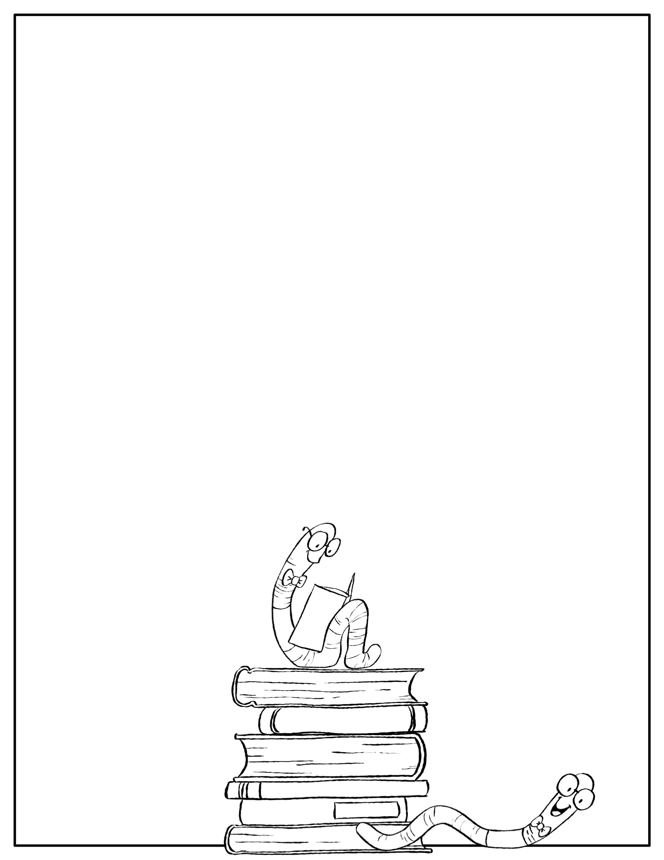
Reading: We use reader’s workshop in third grade. We start each reading block with a warm up that includes fluency, vocabulary, and a specific reading skill (inferring, context clues, etc.). We then have a mini lesson, guided practice with the teacher and then students go off to read books of their choosing at their own level. During this time I confer with students individually or in small groups.
Science/Social Studies: Science and social studies alternate throughout the year. We will start with Michigan geography and plants in science.
Writing: We use writer’s workshop in third grade. Each day students will receive a mini lesson, guided practice with the teacher and then independent writing time. During this time, I will meet with students individually or in small groups. We cover personal narratives, informational writing, research, opinion writing and additional narrative writing.
Again, I am so excited to be your child’s teacher this year! If you ever have questions or concerns, please don’t hesitate to contact me. Thank you in advance for all of your help and support this year.
Erica Abel
eabel@bcpsk12.net

